Slide 1

6th Grade Accelerated Math
Unit 14, Lesson 8 Writing and Solving One-Step Equations in One Variable Volume 2, pg. 378

Slide 2


Benchmarks
MA.6.AR.2.2
Write and solve one-step equations in one variable within a mathematical or real-world context using addition and subtraction, where all terms and solutions are integers.
MA.6.AR.2.3
Write and solve one-step equations in one variable within a mathematical or real-world context using multiplication and division, where all terms and solutions are integers.
volume 2, pg. 378

Slide 3
Integrated Mathematical Thinking and Reasoning Standards
MA.K12.MTR.1.1 Actively participate in effortful learning both individually and collectively.
MA.K12.MTR.2.1 Demonstrate understanding by representing problems in multiple ways.
MA.K12.MTR.4.1 Engage in discussions that reflect on the mathematical thinking of self and others.
MA.K12.MTR.5.1 Use patterns and structure to help understand and connect mathematical concepts.
MA.K12.MTR.6.1 Assess the reasonableness of solutions.
MA.K12.MTR.7.1 Apply mathematics to real-world contexts.
volume 2, pg. 378

Slide 4

Learning Targets
I can write and solve one-step equations in one variable within a real-world context using multiplication and division.
I can solve one-step equations in one variable using addition and subtraction.
volume 2, pg. 378

Slide 5

Warm-Up
volume 2, pg. 379

Slide 6
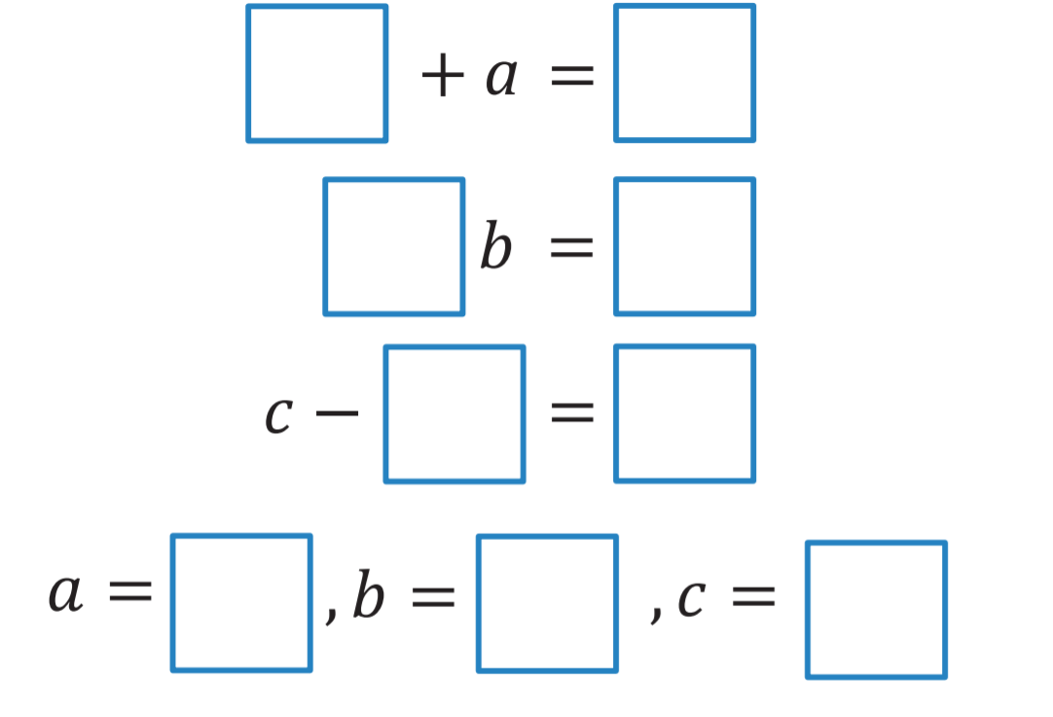
14.8.1 Warm-Up: One-Step Equations
1. Fill in each blue box to make the equations true. Use only digits 1 to 9, at most one time each.
volume 2, pg. 379

Slide 7

Collaboration
volume 2, pg. 379

Slide 8


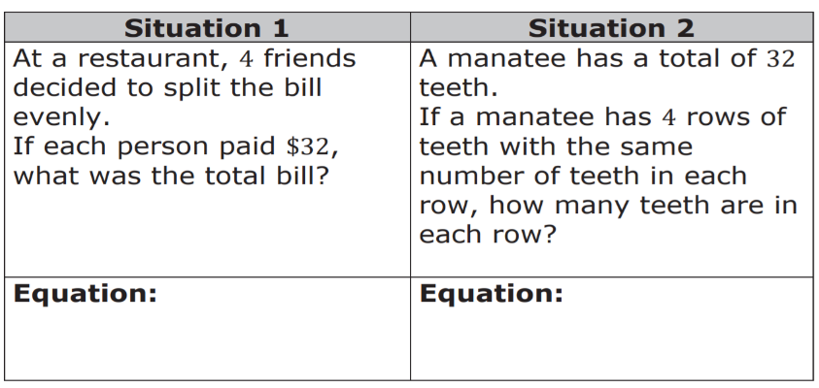
14.8.2 Collaboration: Relating Real-World Contexts to Equations
Four equations are shown.
Discuss with your partner which of the equations
correctly represents each situation below, where 𝑥
represents the unknown quantity. Then, write the
matching equation in the space provided.
volume 2, pg. 379

Slide 9

Guided Instruction
volume 2, pg. 380

Slide 10
14.8.3 Guided Instruction: Solving One-Step Equations Representing Real-World Contexts Using Multiplication and Division
A town's total budget for firefighters’ wages is $320,000.Wages are calculated at $40,000 per firefighter.
Draw a bar model that can be used to determine how many firefighters the town can afford to employ.
Write an equation that can be used to find 𝑤, the number of firefighters the town can employ.
What is the value of 𝑤?
Explain what the solution means in the context of the problem.
volume 2, pg. 380

Slide 11
There are 4 flooring companies submitting bids on a new housing development. Each company has 11 different flooring samples.
Dino said, “To find the total number of samples, 𝑠𝑠, being submitted, set up the equation 𝑠𝑠 = 4 ∙ 11.” Dino’s partner Callahan shared that he used the equation 𝑠𝑠 4 = 11 to find the total number of samples submitted.
Bristol shouted across the classroom that she wrote the equation, 𝑠𝑠 11 = 4.
Discuss with your partner which student — Dino, Callahan, or Bristol — wrote the correct equation to solve for the total number of samples submitted.
Solve one of the equations and then use a different equation to check your work.
Explain how the answer makes sense in terms of the context.
volume 2, pg. 380

Slide 12

Guided Practice
volume 2, pg. 381

Slide 13

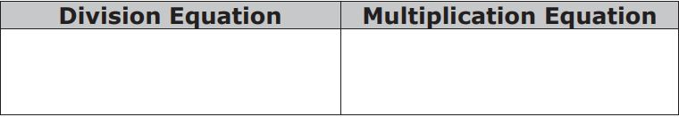
16.8.4 Guided Practice: Solving Multiplication and Division Equations for Real-World Contexts
For each situation, write an equation that can be used to determine the unknown value. Then, solve the equation. Be sure to check your solution.
It takes 5 yards of fabric to make a Native American ceremonial dress.
Write a division equation and a multiplication equation that can be used to determine how many yards, 𝑑, of fabric are needed to make 17 ceremonial dresses.
Solve either of the equations for 𝑑. Use the other equation to check your work.
volume 2, pg. 381

Slide 14
Drake is selling candy bars for a school fundraiser. Each candy bar sells for $3.00.
Write a division equation and a multiplication equation that can be used to determine how many candy bars, 𝑐, he sold if he raised $399.
Solve either of the equations for 𝑑. Use the other equation to check your work.
Discuss with your partner how creating the two
different equations in Questions 1 and 2 demonstrate
inverse relationships.
volume 2, pg. 381

Slide 15

Try It
volume 2, pg. 382

Slide 16

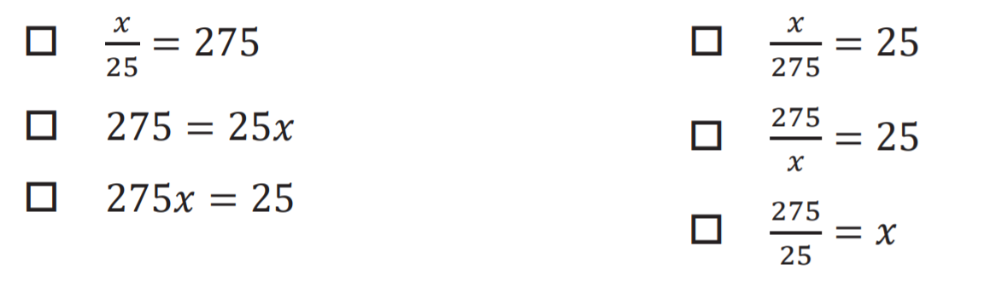
14.8.5 Try It: Mixed Review
Select all of the equations that represent each situation.
One Valencia orange tree can produce 275 oranges. A crate contains 25 oranges.
How many crates can one Valencia orange tree fill
up? Select all that apply.
Pick one of the equations you selected and solve the problem. Show your reasoning.
volume 2, pg. 382

Slide 17
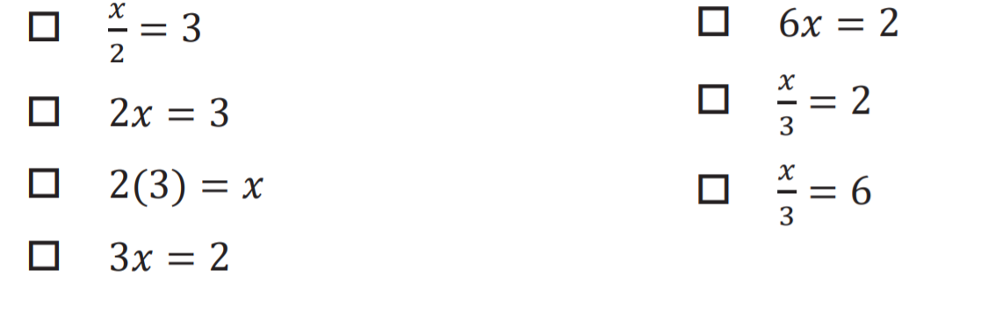
Aliyah and Tiana want to bake 3 carrot cakes. Each carrot cake needs 2 cups of salted butter.
How much butter will they need to bake all 3 cakes? Select all that apply.
Select one of the equations you selected and solve the problem. Show your reasoning.
volume 2, pg. 382

Slide 18
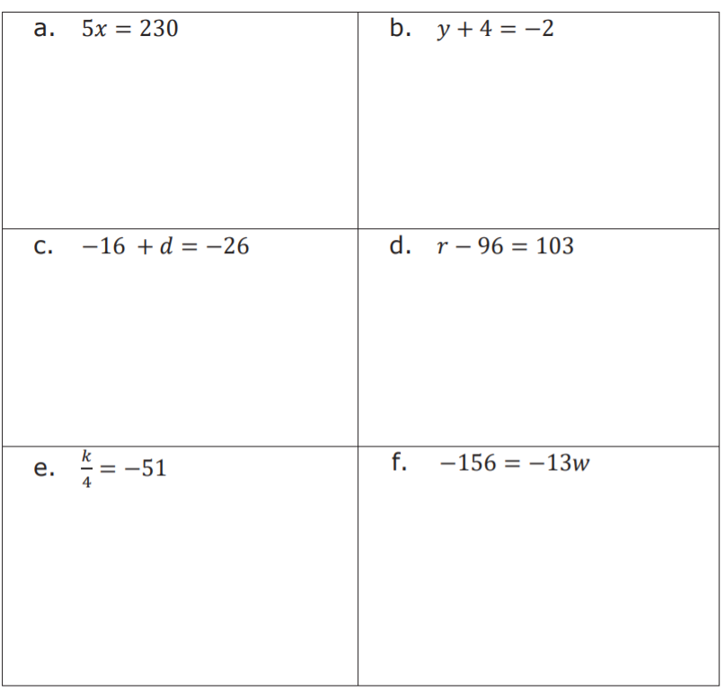
Solve each equation for the variable. Verify your answers.
volume 2, pg. 382

Slide 19

Wrap-Up
volume 2, pg. 383

Slide 20

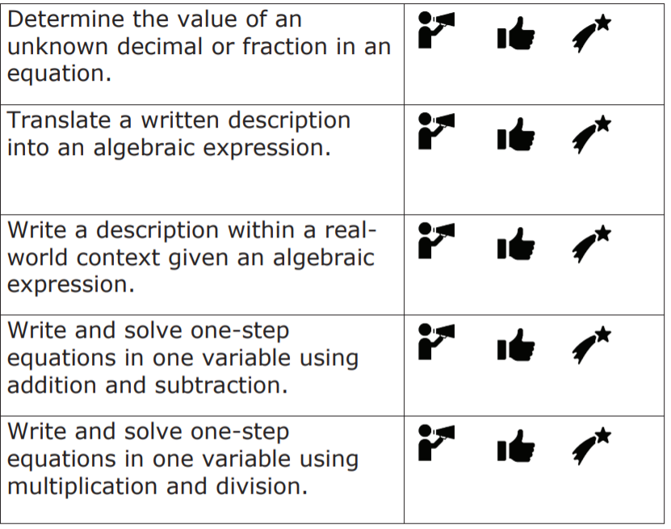
14.8.6 Wrap-Up: Reflection
Circle the icon that best describes your understanding of each learning objective.
volume 2, pg. 383

